Slide 1
Week 6
Computer Vision

Slide 2
What we have learnt in this week’s videos?
Metric Learning
Siamese Network

Slide 3
Session Agenda
Metric Learning
Examples of Metric Learning
Siamese Network
Applications of Siamese Networks
How to train Siamese Networks

Slide 4
Metric Learning

Slide 5
Metric Learning
Metric learning is the task of learning a distance function.

Slide 6
Examples
If considering distance, the objective is to minimize the distance measure.
Euclidean and Manhattan distance.
If considering similarity, the objective is to maximize the similarity measure.
Dot product, RBF.

Slide 7
Siamese Network

Slide 8
Siamese Network
Siamese network is an artificial neural network that use the same weights while working in tandem on two different input vectors to compute comparable output vectors.
Often one of the output vectors is precomputed, thus forming a baseline against which the other output vector is compared.
Siamese neural networks has a unique structure to naturally rank similarity between inputs.

Slide 9
Applications
Paraphrase scoring, where the inputs are two sentences and the output is a score of how similar they are.
Signature verification, where figure out whether two signatures are from the same person.
Face verification, where figure out whether two given face images are from the same person.
And many more...
Generally, in such tasks, two identical subnetworks are used to process the two inputs, and another module will take their outputs and produce the final output.

Slide 10
Why they work?
Siamese networks work well in these tasks because,
Sharing weights across subnetworks means fewer parameters to train for, which in turn means less data required and less tendency to overfit.
Each subnetwork essentially produces a representation of its input. (“Signature Feature Vector” or “Face Feature Vector”)
If your inputs are of the same kind, like matching two pictures, it makes sense to use similar model to process similar inputs. This way you have representation vectors with the same semantics, making them easier to compare.

Slide 11
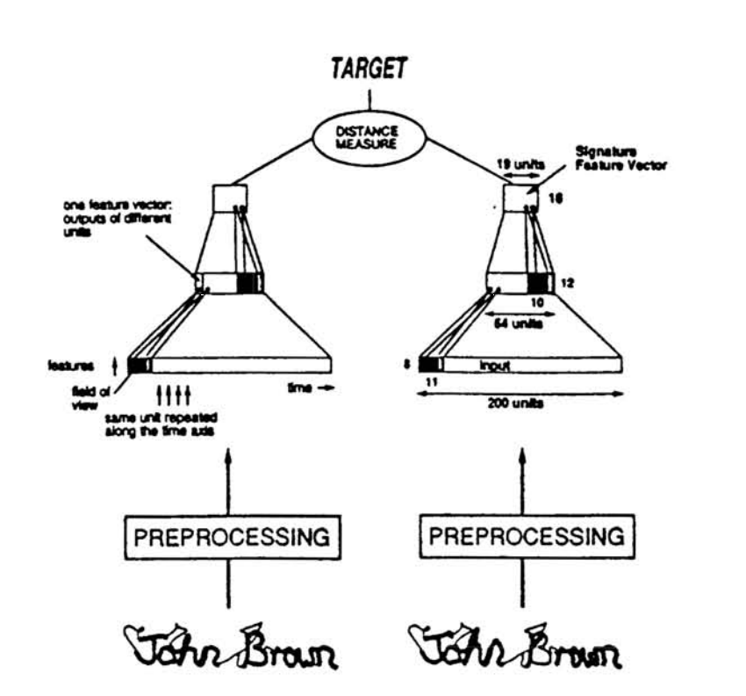
Signature Verification using a Siamese Network @1994
Source: https://papers.nips.cc/paper/769-signature-verification-using-a-siamese-time-delay-neural-network.pdf

Slide 12
How to train a Siamese Network?
Regular or Duplet Siamese Training
Triplet Siamese Training

Slide 13
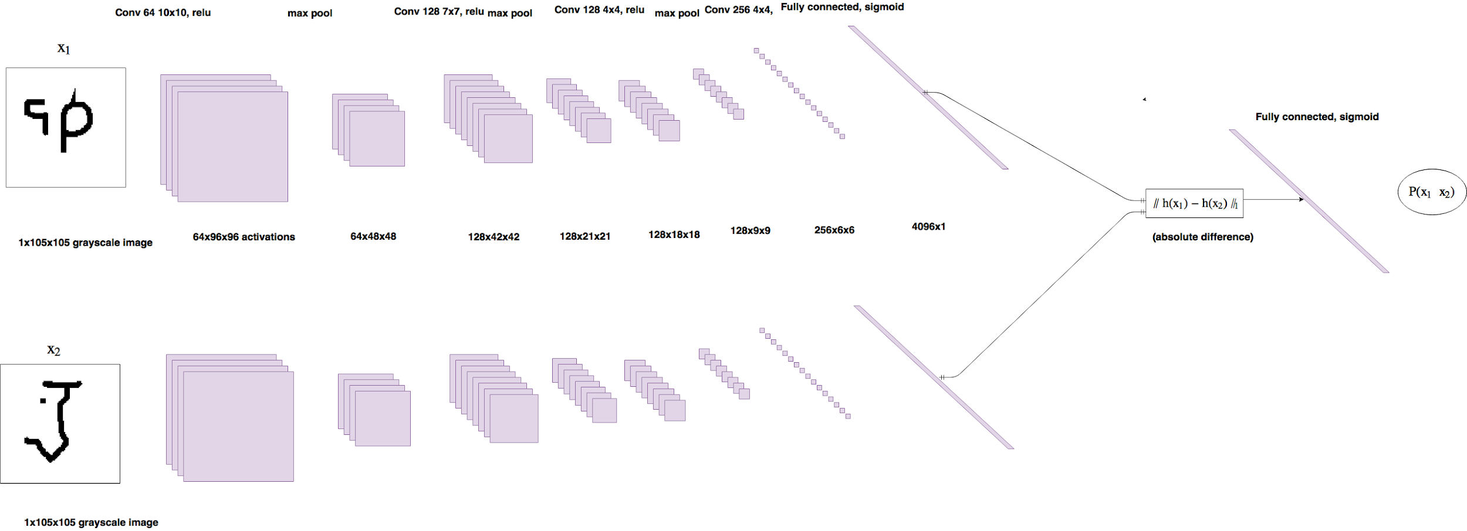
Duplet Siamese Training
Source: https://sorenbouma.github.io/blog/oneshot/

Slide 14
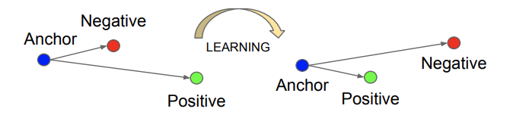
Triplet Loss
Positive
Negative
Anchor
Source: FaceNet: A Unified Embedding for Face Recognition and Clustering
Notes:
One way to learn the parameters of the network to give good face embedding is to apply SGD on Triplet loss. Compare pairs of images. ||fa - fp||^2 to be small <= ||fa - fn||^2.

Slide 15
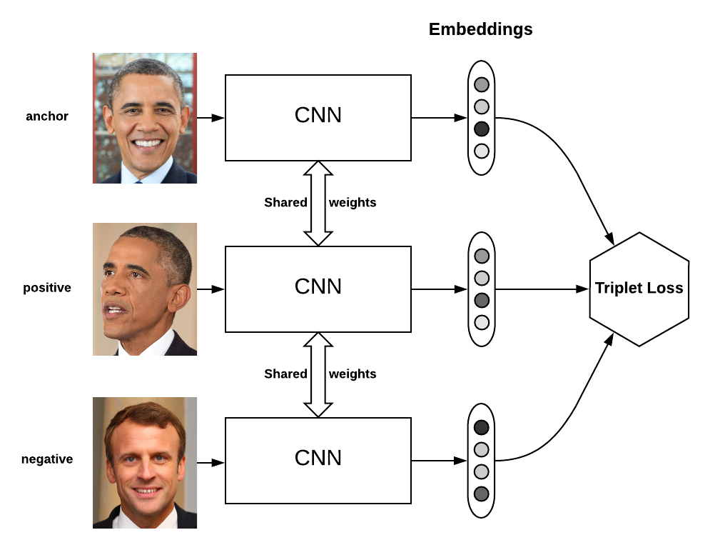
Triplet Siamese Training
Source: https://omoindrot.github.io/triplet-loss

Slide 16


AIML @WORK
PGPAIML @ Great Learning
Enabling Learners to Apply the AI/ML Concepts at Work
Apply AIML at your workplace to gain some instant benefits:
Get noticed by your management with your outstanding analysis backed by data science.
Create an impact in your organization by taking up small projects/initiatives to solve critical issues using data science.
Network with members from the data science vertical of your organization and seek opportunities to contribute in small projects.
Share your success stories with us and the world to position yourself as a subject matter expert in data science.
AIML Operations | AIMLAW
@Great Learning Proprietary Content. All rights reserved. Unauthorized use or distribution prohibited

Slide 17
Summary

Slide 18
Summary
We have learnt about,
Metric Learning
Siamese Network
Applications of Siamese Networks

